Slide 1
Recruit, Select, and Support: Turnaround Leader Competencies
Part 3: Developing and Supporting Turnaround Leaders

Slide 2
Introductions and Overview

Slide 3
Using Turnaround Leader Competencies
Professional Learning Module
Recruit, Select, and Support: Turnaround Leader Competencies
Part 1: Understanding Turnaround Leader Competencies
Part 2: Recruiting and Selecting Turnaround Leaders
Part 3: Developing and Supporting Turnaround Leaders

Slide 4
Partner Organizations

Slide 5
Introductions
Your name
Your role
Characteristic of a high-quality professional development session you have experienced

Slide 6
Part 3: Outcomes
Understand the district’s role in developing and supporting turnaround leaders.
Examine high-quality adult learning and implications for competency-based development of turnaround principals.
Explore how districts can leverage principal supervisors and others to increase turnaround principal competencies.

Slide 7
Part 3: Agenda
Introductions and Overview
Turnaround Leader Competencies
Context: Systems of Support
District Support and Accountability
Turnaround Leader Professional Development
Role of Principal Supervisor
Competency-Based Development in Action
Closing Reflections

Slide 8
Turnaround Leader Competencies

Slide 9
Competencies Review
Competencies are underlying motives and habits—or patterns of thinking, feeling, acting, and speaking—that cause a person to be successful in a specific job or role.
Competencies lead to actions that lead to outcomes.
Competencies explain some of the differences in performance levels of leaders.
Competencies can be measured and intentionally developed.
(Spencer & Spencer, 1993; Steiner & Hassel, 2011)

Slide 10
Turnaround Leader Competencies
Driving for Results
Achievement / Focus on Sustainable Results
Influencing for Results
Impact and Influence
Problem Solving
Analytical Thinking
Conceptual Thinking
Monitoring & Directiveness / Holding People Accountable
Initiative & Persistence
Planning Ahead
Personal Effectiveness
Team Leadership / Engaging the Team
Developing Others
Self-Confidence / Commitment to Student Learning
Belief in Learning Potential
(Public Impact, 2008; Spencer & Spencer, 1993; Zhu, Hitt, & Woodruff, 2015)

Slide 11
Turnaround Schools Systems of Support

Slide 12
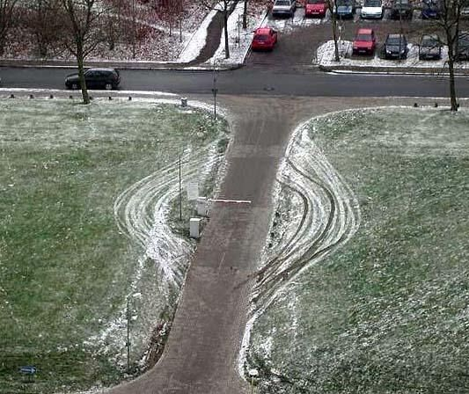
“Every system is perfectly designed to get the results it gets.”
—Quotation from Paul Batalden, M.D.

Slide 13
School Turnaround Context
Community
Turnaround
School
Commitment to Change
Community Engagement
Teacher Selection
Leader Selection
Leader
Autonomy
Leader Development
Leader Accountability
District

Slide 14
How Districts Support Turnaround
Commit to success.
Choose turnarounds for the right schools.
Develop a pipeline of turnaround leaders.
Give leaders the “Big Yes” (autonomy).
Hold leaders accountable for results, and support them to meet expectations.
Prioritize teacher hiring in turnaround schools.
Proactively engage the community.
(Kowal, Hassel, & Hassel, 2009)

Slide 15
Self-Assessment: How Districts Support Turnaround
Using the self-assessment tool individually or in teams, reflect on how your district or the districts you serve currently support turnaround.
Discuss the implications of your current state.
How are supports different for turnaround and non-turnaround schools?
How are supports different for district-run/charter, urban/rural schools?
What are the barriers to district support for turnaround schools?
Share two ideas from your discussion with the whole group.

Slide 16
District Support and Accountability

Slide 17
Principle of Reciprocity
Accountability must be a reciprocal process.
For every increment of performance I demand from you, I have an equal responsibility to provide you with the capacity to meet that expectation.
Likewise, for every investment you make in my skill and knowledge, I have a reciprocal responsibility to demonstrate some new increment in performance.
This is the principle of reciprocity of accountability for capacity. It is the glue that, in the final analysis, will hold accountability systems together.
(Elmore, 2002)

Slide 18
Support and Accountability: An Unbeatable Match
ACCOUNTABILITY
Effective Turnaround Leader
SUPPORT
(Hitt, 2015; Hitt & Tucker, 2015)

Slide 19
Activity: Support and Accountability
Individually:
Describe how you define “supporting” someone. Include two synonyms for support.
Describe how you define “holding someone accountable.” Include two synonyms for accountability.

Slide 20
Development = Supporting + Holding Accountable
Supporting
Monitoring/measuring
Generating insight
Teaching new concepts/skills
Coaching and mentoring
Reflecting on practice
Setting goals
Observing
Assessing formatively
Providing feedback
Your ideas!
Holding Accountable
Monitoring/measuring
Reminding
Calling attention to
Checking on
Pointing out
Expecting
Redirecting
Assessing summatively
Evaluating
Your ideas!

Slide 21
Activity: Support and Accountability
With your team:
Identify differences between supporting turnaround leaders and school leaders in non-turnaround schools.
Be prepared to share with the whole group.

Slide 22
Turnaround Leader Professional Development
Notes:
Section on Professional Development – needs to be reworked to help make a distinction between PD for turnaround leaders and other leaders in the district

Slide 23
Competency-Based Development for Turnaround Principals
Review the Turnaround Leader Competencies
Turn and Talk:
How might these competencies be developed?
How could the district be supportive and hold turnaround principals accountable?

Slide 24
Competency-Based Support and Accountability
Supportive Professional Development: Provide high- quality professional development that comprises a coherent set of experiences intended for turnaround principals to cultivate the competencies and actions necessary for turnaround success.
Generative Accountability Structures: Evaluate on the basis of, expect use of, and provide feedback and focus on the competencies and actions that matter for turnaround.
(Hitt, 2015)

Slide 25
High-Quality Professional Development: What is your experience?
Write two or three sentences about what made this example “high quality.”
Write two or three sentences about how it changed your practice or perspective about your job, OR how you think it did so for your audience.
Turn and share with a partner next to you.
Create a list that synthesizes what each of you said.
Make notes to be to shared with the group.

Slide 26
High-Quality School Leader Development: What does the research say?
Content focused on improved instruction and school change
Differentiated to address varied leader needs
Collegial networks and protocols for collaboration
Job-embedded instruction and applications of learning
Long-term delivery with multiple learning opportunities
Sharing from experts or experienced practitioners
Mentoring and coaching to fit individual and school needs
(Drago-Severson, Asghar, Blum-DeStefano, & Welch, 2011; Goldring, Preston, & Huff, 2012; and Mitgang, 2012)

Slide 27
Activity: Competency-Based Leadership Development
Developing Turnaround Leader Competencies
Individually or as a team:
Reflect on your current practices in turnaround leader development.
Identify changes you would make to better meet the development needs of turnaround leaders.

Slide 28
Role of Principal Supervisors

Slide 29
Role of Principal Supervisor
The primary roles of the principal supervisor are:
Professional development and coaching
Evaluation and feedback
Liaison between school and district
Buffering and barrier removal
The role of principal supervisors becomes more important when we consider the potential they have to bolster efforts of turnaround principals through individualization.

Slide 30
Principal Supervisors and Implications for Turnaround Principals
Principal supervisors should:
Have a limited number of turnaround principals.
Have weekly interactions with each turnaround principal.
Develop and participate in evaluation of their turnaround principals.
Be thoughtfully matched with turnaround principals.
(Corcoran et al., 2013)

Slide 31
How do districts, via principal supervisors, develop turnaround principals?
Diagnosing competency levels
Setting leader development goals
Facilitating leader development
Frequently observing and providing feedback
Monitoring and adjusting development plans

Slide 32
1. Diagnosing Competency Levels
The principal supervisor and turnaround principal review evaluations of turnaround principal competencies and identify strengths and areas for improvement.
Conduct behavior event interview (BEI), or use BEI results from selection process, to identify competencies.
Conduct self-evaluations that elicit the principal’s perception of his or her own competencies.
Conduct 360 evaluations that solicit feedback from others on perceptions of principal competencies.
Document and assess competencies through school review site visit interviews, focus groups, and observations.

Slide 33
2. Setting Leader Development Goals
Using data, the principal supervisor and turnaround principal work together to pinpoint the highest leverage competencies to identify:
Strengths and set goals to leverage strengths.
Competencies that are partially developed but could be quick wins, if developed further.
Stretch goals in areas that are relative weaknesses but could increase leader effectiveness.

Slide 34
3. Facilitating Leader Development
Based on the individualized goals and development plans, principal supervisors and turnaround principals identify aligned development experiences such as:
Relevant reading and training opportunities
Visits to successful schools
Peer-to-peer learning opportunities
Coaching and mentoring
Leadership rounds

Slide 35
4. Observing and Providing Feedback
Principal supervisors frequently observe turnaround principals and provide feedback on leader actions.
Schedule frequent observation and feedback meetings.
Conduct observations of leader actions in a variety of settings: leadership team, teacher teams, faculty meetings, teacher observations and feedback, professional development, etc.
Provide feedback aligned to the turnaround principal leader development goals and action plans.

Slide 36
5. Monitoring and Adjusting Development Plans
The turnaround principal, with feedback from the principal supervisor, monitors progress and identifies actions they will take to reach development goals.
Identify leader actions, timeline, and expected impact.
Frequently review status of actions and impact.
Determine next actions, timeline, and expected impact.
Repeat, in a cycle of continuous improvement.

Slide 37
Activity: Triad Conversation
What is one thing principal supervisors in your district could do that would have the greatest impact on increasing the effectiveness of turnaround principals?

Slide 38
Competency-Based Development in Action

Slide 39
Individual Versus Whole-Group Development

Slide 40
Competency-Based Turnaround Principal Development: How does it look in action for an individual principal?
Let’s take a look at the work of one principal supervisor.
Individually:
Read the case study, Individualized Turnaround Principal Development: How Does It Look in Action?
In what ways does the story reflect what we know about high-quality interactions between a supervisor and a turnaround principal?
As a Pair:
What suggestions do you have for additional ways this supervisor might build on and deepen her competency-based development work with her principals? (5 minutes)

Slide 41
Competency-Based Turnaround Principal Development: How does it look in action for an individual principal?
Case Study
Work in a group of two pairs:
Take turns presenting each pair’s enhanced version of what the principal supervisor could do. (4 minutes)
Discuss as a group what might be some challenges or barriers for principal supervisors. (2 minutes)
Reconvene in your team:
What are some implications for your district in terms of supporting principal supervisors? (5 minutes)

Slide 42
Turnaround Principal Development: How does it look in action for multiple principals?
Individually:
Read the case study, Group Turnaround Principal Development: How Does It Look in Action?
How does Akron use competencies to discern needs for formalized training of leaders?
As a team:
Are there processes your district uses that are similar to those described in Akron?
How is this different from how your district currently decides how and what leaders should formally learn in training?

Slide 43
Activity: Gap Analysis
As a team:
What are the needs of turnaround principals in your district?
What are your current systems for support and accountability?
What are the gaps between needs and supports?

Slide 44
State Systems of Support
Notes:
Thinking about Implications

Slide 45
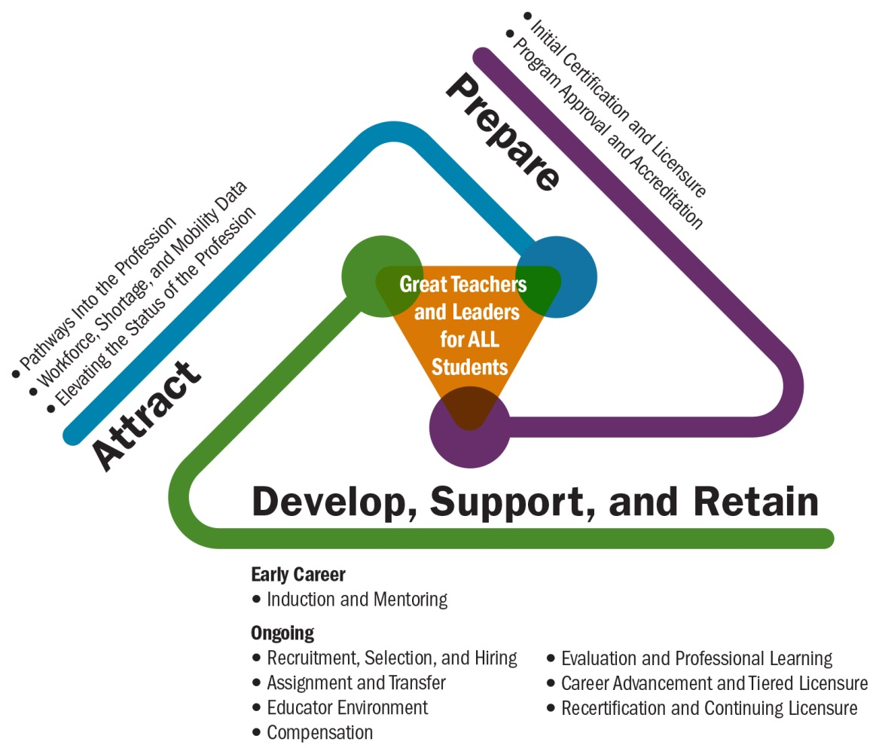
Talent Development Framework
(Center on Great Teachers and Leaders, 2014)
(Center on Great Teachers and Leaders, 2014)

Slide 46
Closing and Commitments

Slide 47
Closing and Commitments
What are you taking away with you today? (What were your key learnings? What resonated most with you? What are you sure of? What do you want to learn more about?)
What will you commit to do to support competency-based development of turnaround principals?
Be ready to share your thoughts.
Notes:
1. Take a moment to makes notes about what your key learnings are today. What resonated most with you? What are you sure of? What do you want to learn more about?
2. Given the questions we just looked at regarding implications for SEAs, what can you do to support competency based development of principals?
Be ready to share your thoughts on one of these with the group.

Slide 48
Using Turnaround Leader Competencies
Professional Learning Module
Recruit, Select, and Support: Turnaround Leader Competencies
Part 1: Understanding Turnaround Leader Competencies
Part 2: Recruiting and Selecting Turnaround Leaders
Part 3: Developing and Supporting Turnaround Leaders

Slide 49
References
Center on Great Teachers and Leaders. (2014). Talent development framework for 21st century educators: Moving toward state policy alignment and coherence. Washington, DC: Author. Retrieved from http://www.gtlcenter.org/talent_development_framework
Corcoran, A., Casserly, M., Price-Baugh, R., Walston, D., Hall, R., & Simon, C. (2013). Rethinking leadership: The changing role of principal supervisors. Washington, DC: Council of the Great City Schools. Retrieved from http://www.wallacefoundation.org/knowledge-center/school-leadership/district-policy-and-practice/Pages/Rethinking-Leadership-The-Changing-Role-of-Principal-Supervisors.aspx
Drago-Severson, E., Asghar, A., Blum-DeStefano, J., & Welch, J. R. (2011). Conceptual changes in aspiring school leaders: Lessons from a university classroom. Journal of Research on Leadership Education, 6(4), 83–132.
Elmore, R. F. (2002). Bridging the gap between standards and achievement. Washington, DC: Albert Shanker Institute.
Goldring, E., Preston, C., & Huff, J. (2012). Conceptualizing and evaluating professional development for school leaders. Planning and Changing, 43(3/4), 223–242. Retrieved from http://works.bepress.com/cgi/viewcontent.cgi?article=1007&context=kristina_hesbol
Hitt, D. H. (2015). What it takes for a turnaround: Principal competencies that matter for student achievement. A guide to thoughtfully identifying and supporting turnaround leaders. Sacramento, CA, & Charlottesville, VA: Center on School Turnaround at WestEd & University of Virginia Darden/Curry Partnership for Leaders in Education.

Slide 50
References
Hitt, D. H., & Tucker, P. D. (2015, November). Systematic review of key leader practices found to influence student achievement: A unified framework. Review of Educational Research. doi: 10.3102/0034654315614911
Kowal, J., Hassel, E., & Hassel, B. (2009). Successful school turnarounds: Seven steps for district leaders (Issue Brief). Washington, DC: The Center for Comprehensive Reform and Improvement. Retrieved from http://files.eric.ed.gov/fulltext/ED507589.pdf
Mitgang, L. (2012). The making of the principal: Five lessons in leadership training (Perspective). New York: The Wallace Foundation. Retrieved from http://www.wallacefoundation.org/knowledge-center/school-leadership/effective-principal-leadership/Pages/The-Making-of-the-Principal-Five-Lessons-in-Leadership-Training.aspx
Public Impact. (2008). School turnaround leaders: Competencies for success (for the Chicago Public Education Fund). Chapel Hill, NC: Author. Retrieved from http://publicimpact.com/web/wp-content/uploads/2009/09/Turnaround_Leader_Competencies.pdf
Spencer, L. M., & Spencer, S. M. (1993). Competence at work: Models for superior performance. New York: John Wiley and Sons.
Steiner, L., & Hassel, E. A. (2011). Using competencies to improve school turnaround principal success. Charlottesville, VA: University of Virginia Darden/Curry Partnership for Leaders in Education. Retrieved from http://www.darden.virginia.edu/uploadedFiles/Darden_Web/Content/Faculty_Research/Research_Centers_and_Initiatives/Darden_Curry_PLE/School_Turnaround/using-competencies-to-improve-school-turnaround.pdf
Zhu, G., Hitt, D. H., & Woodruff, D. (2015). Identifying and validating a model for school turnaround. Manuscript submitted for publication.

Slide 51
Partner Organizations
For more information on the Partner Organizations:
Center on Great Teachers and Leaders http://www.gtlcenter.org/
Center on School Turnaround http://centeronschoolturnaround.org/
Public Impact http://publicimpact.com/
Darden/Curry Partnership for Leaders in Education http://www.darden.virginia.edu/darden-curry-ple/

Slide 52
Presenter Name
Address
Phone
E-mail
Website

