Slide 1
Recruit, Select, and Support: Turnaround Leader Competencies
Part 2: Recruiting and Selecting Turnaround Leaders

Slide 2
Welcome and Introductions

Slide 3
Introductions
Your name
Your role
What does it take to be a school turnaround leader?

Slide 4
Overview, Outcomes, and Agenda

Slide 5
Using Turnaround Leader Competencies
Professional Learning Module
Recruit, Select, and Support: Turnaround Leader Competencies
Part 1: Understanding Turnaround Leader Competencies
Part 2: Recruiting and Selecting Turnaround Leaders
Part 3: Developing and Supporting Turnaround Leaders

Slide 6
Partner Organizations

Slide 7
Part 1: Review
Part 1: Understanding Turnaround Leader Competencies
Acknowledged the unique challenges of leading school turnaround.
Identified leader competencies and actions associated with turnaround success.
Explored the importance of competencies in turnaround leader selection and development.
Analyzed school leader behaviors to identify evidence of competencies.

Slide 8
Part 2: Outcomes
Part 2: Recruiting and Selecting Turnaround Leaders
Understand the importance of competencies in recruiting and selecting turnaround leaders.
Explore ways to recruit leaders with competencies to turn around persistently low-performing schools.
Experience a competency-based interview and selection process for turnaround leaders.

Slide 9
Part 2: Agenda
Part 2: Recruiting and Selecting Turnaround Leaders
Overview, outcomes, and agenda
Turnaround leader talent management
Competency-based recruitment of turnaround leaders
Competency-based selection of turnaround leaders
Closing and next steps

Slide 10
Warm Up: Metaphorical Thinking
Turnaround leaders are like ______________________
because _________________________.

Slide 11
Competency-Based Talent Management

Slide 12
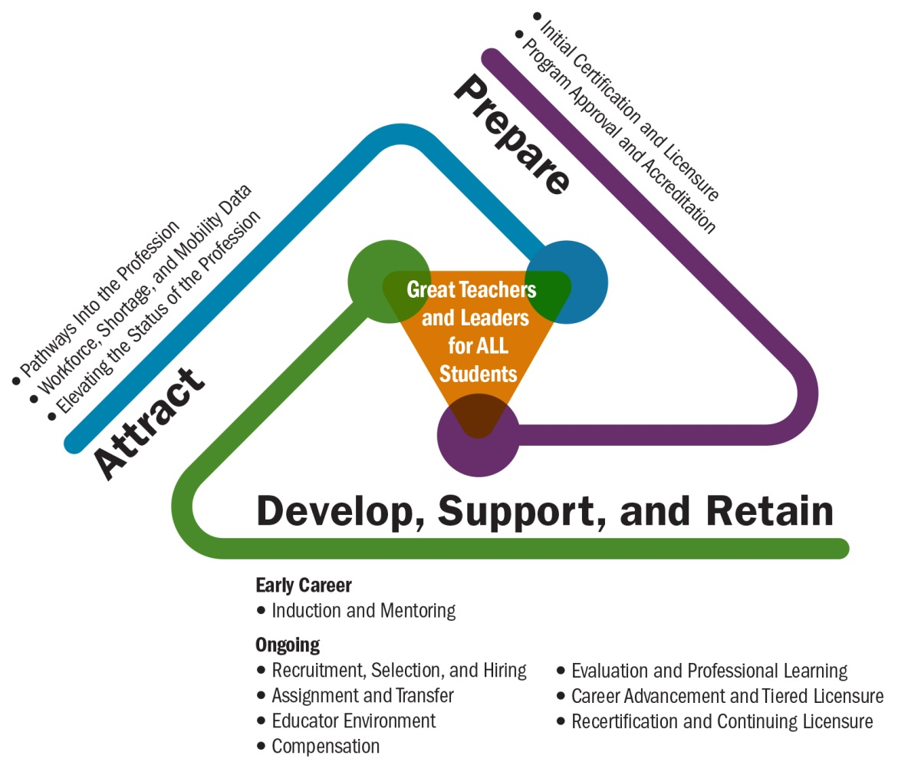
Talent Development Framework
(Center on Great Teachers and Leaders, 2014)
Source: Center on Great Teachers and Leaders (2014)

Slide 13
Turnaround Leaders
“Typical school district practices are not designed to recruit and select talent for challenging schools, including the bold leaders needed for turnaround schools.”
(Steiner & Hassel, 2011, p. 2)

Slide 14
Turnaround Leader Competencies
Driving for Results
Achievement / Focus on Sustainable Results
Influencing for Results
Impact and Influence
Problem Solving
Analytical Thinking
Conceptual Thinking
Monitoring & Directiveness / Holding People Accountable
Initiative & Persistence
Planning Ahead
Personal Effectiveness
Team Leadership / Engaging the Team
Developing Others
Self-Confidence / Commitment to Student Learning
Belief in Learning Potential
(Public Impact, 2008; Spencer & Spencer, 1993; UVA Partnership for Leaders in Education, 2014)

Slide 15
Competency-Based Talent Management
Years of experience and academic degrees are not accurate predictors of performance.
Competencies—habits of behavior and underlying motivations—can be used to distinguish among performance outcomes.
Using competencies to select turnaround leaders could increase the likelihood that turnaround efforts succeed.
(Steiner & Hassel, 2011)

Slide 16
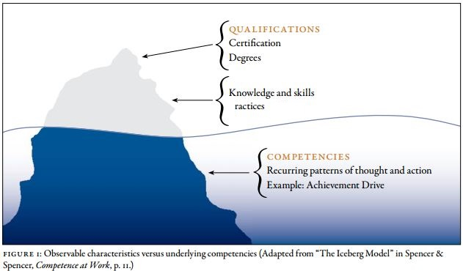
Talent Management
P

Slide 17
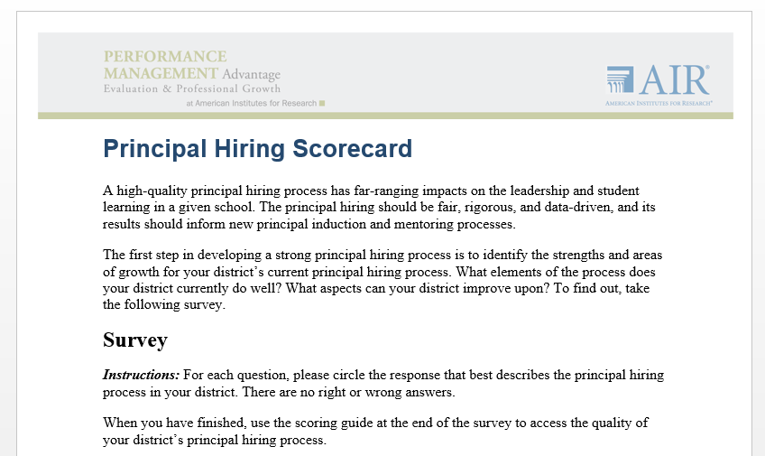
Activity: Principal Hiring Scorecard

Slide 18
Reflection: Competency-Based Leader Selection
Think-Pair-Share
Where do competencies fit in your current leader selection process?
How could your current leader selection process be modified to include turnaround leader competencies?

Slide 19
Recruiting Turnaround Leaders

Slide 20
Obstacles to Hiring Turnaround Leaders
A shortage of high-quality principal candidates
More demanding
Limited authority and autonomy
Insufficient pay to attract enough candidates
Not selecting the best candidates from the limited pool
Limited investments in recruiting and selecting candidates
Overreliance on internal candidates
Lack of rigor in selection criteria and processes
Administrative inefficiencies resulting in a loss of applicants
Prolonged interview and hiring process and delays
Lack of clear vision and support for leaders
(Doyle & Locke, 2014; TNTP, 2006; Clifford, 2012)

Slide 21
How Can We Improve the Process?
Make the job more appealing—and manageable.
Pay great leaders what they are worth.
Take an active approach to recruitment.
Evaluate candidates against the competencies and skills that research shows successful principals demonstrate.
Design the placement process to match particular schools’ needs with particular candidates’ strengths.
Continually evaluate hiring efforts.
(Doyle & Locke, 2014)

Slide 22
Recruitment and Selection Process
Recruitment. The district engages in intensive efforts to attract a large and diverse pool of prospective principal candidates from both internal and external sources.
Initial Eligibility Screen. The district makes a preliminary assessment as to each candidate’s basic eligibility.
District Competency Screening. The candidate is evaluated by trained selectors against an objective set of criteria (interviews and performance tasks).
School Fit Panel Interviews. From interviews, a diverse group of school representatives makes a recommendation as to the candidate’s potential fit with their school.
Hiring. The district superintendent or an appropriate designee formally approves the hire.
(TNTP, 2006)

Slide 23
Building a Candidate Pool
Define a Profile of a High-Quality Candidate
Develop and Execute a Recruiting Strategy
Project need
Prepare recruiters
Establish an identity
Attract and identify candidates
Determine those with the highest potential
Cultivate and convert high-potential candidates into applicants
3. Build a Pipeline of New Rising Talent
(Cheney, Davis, Garrett, & Holleran, 2010)

Slide 24
Competency-Based Recruiting
Articulate the mission, vision, and goals
Identify autonomy, support, and other appealing conditions
Compensate for additional demands and responsibilities
Develop criteria for identifying candidates with turnaround leader competencies
Solicit recommendations and target outreach to external candidates
Identify and cultivate high-potential internal candidates
Eliminate barriers that might discourage potential talent
(Doyle & Locke, 2014)

Slide 25
Activity: Recruitment
Analyze job announcement and description.
Why would a turnaround leader want this job?
What are turnaround leader competencies articulated in this job description?

Slide 26
Selecting Turnaround Leaders

Slide 27
Recruitment and Selection Process
Recruitment. The district engages in intensive efforts to attract a large and diverse pool of prospective principal candidates from both internal and external sources.
Initial Eligibility Screen. The district makes a preliminary assessment as to each candidate’s basic eligibility.
District Competency Screening. The candidate is evaluated by trained selectors against an objective set of criteria (interviews and performance tasks).
School Fit Panel Interviews. From interviews, a diverse group of school representatives makes a recommendation as to the candidate’s potential fit with their school.
Hiring. The district superintendent or an appropriate designee formally approves the hire.
(TNTP, 2006)

Slide 28
Interview Role Play
Form triads:
Candidate
Interviewer
Note taker
Interview question: What is the most important thing a school leader can do to increase student achievement?
Notes:
Four minutes in triads

Slide 29
Behavioral Event Interviews
Why is a behavioral event interview (BEI) better than a traditional interview?
Competencies are key predictors of how someone will perform at work.
Two leaders with the same training and number of years of experience may have very different performance outcomes.
BEIs ask candidates to describe detailed actions and thinking in past work events.
Knowing actions that candidates have taken in the past is a strong predictor of actions they will take in the future.
(Public Impact, 2008)

Slide 30
Overview of the Behavioral Event Interview Process
BEI Process:
Ask the candidate to recall a recent past event when he or she felt successful or dealt with specific situations.
Ask for a brief summary of what led up to each situation and the critical milestones or headlines in the story.
Ask the candidate to systematically walk through the story, recounting exactly what he or she did, said, thought, and felt and how others responded.
Interrupt to probe for detail and stay focused on the candidate’s actions, not on the actions of a team.
(Public Impact, 2008)

Slide 31
Interview Role Play
BEI triad
Candidate
Interviewer
Note taker
Interview question: Think about a time when you felt very successful or proud of something you accomplished at work and tell me the story.

Slide 32
Turnaround Leader Competencies
Two critical competencies for turnaround leaders:
Achievement / Focus on Results
Impact and Influence
Debrief: What do you notice about the two interview formats?
See handout with detailed descriptions.
Notes:
Add rubric descriptions of competencies.

Slide 33
Matching Leaders and Schools
Placement should add to the overall hiring process by providing all schools with the best possible match given their unique needs and the strengths of individual candidates.
Assess School Needs. Work with each school community to determine its challenges and strengths to identify the type of leader most likely to succeed at the school.
Develop Criteria to Assess a Candidate’s Fit With the School. Create a rubric or similar tool to objectively compare how well different candidates fit with a particular school based on the school’s needs assessment and choose the best match.
(Doyle & Locke, 2014)

Slide 34
Closing and Next Steps

Slide 35
Wrap-Up: Reflection
Summarize the learning.
Commit to action.

Slide 36
Using Turnaround Leader Competencies
Professional Learning Module
Recruit, Select, and Support: Turnaround Leader Competencies
Part 1: Understanding Turnaround Leader Competencies
Part 2: Recruiting and Selecting Turnaround Leaders
Part 3: Developing and Supporting Turnaround Leaders

Slide 37
References
Center on Great Teachers and Leaders. (2014). Talent development framework for 21st century educators: Moving toward state policy alignment and coherence. Washington, DC: Author. Retrieved from http://www.gtlcenter.org/talent_development_framework
Cheney, G., Davis, J., Garrett, K., & Holleran, J. (2010). A new approach to principal preparation: Innovative programs share their practices and lessons learned. Rainwater Leadership Alliance. Retrieved from http://www.anewapproach.org/docs/a_new_approach.pdf
Clifford, M. (2012). Hiring quality school leaders: Challenges and emerging practices. Washington, DC: American Institutes for Research. Retrieved from http://www.air.org/resource/hiring-quality-school-leaders-challenges-and-emerging-practices
Doyle, D., & Locke, G. (2014). Lacking leaders: The challenges of principal recruitment, selection, and placement. Washington, DC: Fordham Institute. Retrieved from http://publicimpact.com/lacking-leaders/
Kowal, J., & Hassel, E. A. (2011). Importing leaders for school turnarounds: Lessons and opportunities. Charlottesville: University of Virginia’s Darden/Curry Partnership for Leaders in Education. Retrieved from http://www.darden.virginia.edu/uploadedFiles/Darden_Web/Content/Faculty_Research/Research_Centers_and_Initiatives/Darden_Curry_PLE/School_Turnaround/importing-leaders-for-school-turnarounds.PDF

Slide 38
References
Public Impact. (2008). School turnaround leaders: Selection toolkit. Chapel Hill, NC: Author. Retrieved from http://www.publicimpact.com/publications/Turnaround_Leader_Selection_Toolkit.pdf
Public Impact. (2015a). Opportunity culture recruitment toolkit. Chapel Hill, NC: Author. Retrieved from http://opportunityculture.org/wp-content/uploads/2015/04/Recruitment_Toolkit-Public_Impact.pdf
Public Impact. (2015b). Opportunity culture selection toolkit. Chapel Hill, NC: Author. Retrieved from http://opportunityculture.org/selection-toolkit/
Spencer, L. M., & Spencer, S. M. (1993). Competence at work: Models for superior performance. New York, NY: John Wiley and Sons.
Steiner, L., & Hassel, E. A. (2011). Using competencies to improve school turnaround principal success. Charlottesville: University of Virginia’s Darden/Curry Partnership for Leaders in Education. Retrieved from http://www.darden.virginia.edu/uploadedFiles/Darden_Web/Content/Faculty_Research/Research_Centers_and_Initiatives/Darden_Curry_PLE/School_Turnaround/using-competencies-to-improve-school-turnaround.pdf
TNTP. (2006). Improved principal hiring: The New Teacher Project’s findings and recommendations for urban schools. Brooklyn, NY: Author. Retrieved from http://www.broadeducation.org/asset/1128-tntpimprovedprincipalhiring.pdf

Slide 39
Partner Organizations
For more information on the Partner Organizations:
Center on Great Teachers and Leaders http://www.gtlcenter.org/
Center on School Turnaround http://centeronschoolturnaround.org/
Public Impact http://publicimpact.com/
Darden/Curry Partnership for Leaders in Education http://www.darden.virginia.edu/darden-curry-ple/

Slide 40
Presenter Name
Address
Phone
Email
Website

