Slide 1
Coaching and Developing Turnaround Leader Actions
Professional Learning Module

Slide 2
Introductions, Agenda, and Outcomes

Slide 3
Partner Organizations

Slide 4
Introductions
Your name
Your role
Your best ever development experience

Slide 5
Agenda
Introductions, Agenda, and Outcomes
Connecting Turnaround Leader Actions and Competencies
Assessing Leader Actions
Coaching Turnaround Leaders
Creating a Leadership Development Plan
Closing Reflections and Next Steps

Slide 6
Outcomes
Understand the connection between turnaround leader competencies and the actions of successful turnaround principals and leadership teams.
Learn strategies for coaching and developing turnaround leaders and supporting implementation of key turnaround leader actions.

Slide 7
Rationale
School turnarounds require strong leaders with the necessary competencies to succeed.
Turnarounds also call for leaders to take high-leverage actions. Leaders need to know not only which actions to take but also when and how to take them within a given context.
Coaching helps develop competencies and increases the application of knowledge and skills. Therefore, coaching is critically important in the development and support of turnaround leaders.

Slide 8
Need for Principal Development
What percentage of new principals are still at their school after 3 years?
What percentage of funding for training programs goes to principal development?
About half of new principals leave their schools within 3 years.
Of the approximately $1 billion provided annually to districts for training programs, only 9% of funds go toward supporting principals, whereas 91% is used for teachers.
School Leaders Network. (2014). CHURN: The high cost of principal turnover. Retrieved from http://connectleadsucceed.org/sites/default/files/principal_turnover_cost.pdf

Slide 9
Connecting Turnaround Leader Actions and Competencies

Slide 10
Turnaround Logic Model
Leading
Indicators
Academic Achievement Outcomes
Conditions
School-Based Practices
Great leader/ competencies
Great teachers/ competencies
Autonomy: people, time, money, programs
Funding
Support from state, district, and external providers
Leader actions
Turnaround planning
Instructional practices
Staffing
Scheduling
School culture and climate
Family and community engagement
Performance management
Adult Behaviors
↑ Teacher retention
↑ Teacher attendance
↑ Teacher effectiveness
↑ Leader effectiveness
↑ Satisfaction
Student Behaviors
↑ Student retention
↑ Student attendance
↑ Graduation
↑ Advanced courses
↑ Satisfaction
↑ Enrollment
↓ Discipline incidents
Short-Term Outcomes
Midyear/interim achievement
Intermediate Outcomes
Achievement and growth on annual state assessments
College and career readiness
Long-Term Outcomes
College and career success
Lutterloh, C., Cornier, J. P., & Hassel, B. C. (2016). Measuring School Turnaround Success. San Francisco, CA: WestEd.

Slide 11
Turnaround Theory of Action
IF schools and districts hire great leaders and teachers with turnaround competencies and provide them with adequate autonomy, funding, and support; and
IF they implement effective school-based practices…
THEN leader and teacher effectiveness and student engagement, behavior, and learning will increase; and
THEN student achievement, graduation rates, and college and career success will improve.
Lutterloh, C., Cornier, J. P., & Hassel, B. C. (2016). Measuring School Turnaround Success. San Francisco, CA: WestEd.

Slide 12
Turnaround Leader Competencies
Competencies are underlying motives and habits—or patterns of thinking, feeling, acting, and speaking—that cause a person to be successful in a specific job or role.
Competencies lead to actions that lead to outcomes.
Competencies explain some of the differences in performance levels of leaders.
Competencies can be measured and intentionally developed.
(Spencer & Spencer, 1993; Steiner & Hassel, 2011)

Slide 13
The Iceberg Model
Qualifications:
Certification
Degrees
Knowledge & Skills:
Leader Actions
Competencies:
Recurring patterns of thought and action
Example: Achievement drive
Adapted from “The Iceberg Model” in Spencer & Spencer, Competence at Work, p. 11.

Slide 14
Turn and Talk
Think about a strong turnaround leader and tell your partner about this person: What makes him or her a strong leader?

Slide 15
Turnaround Leader Competencies
Driving for Results
Achievement / Focus on Sustainable Results
Influencing for Results
Impact and Influence
Problem Solving
Analytical Thinking
Conceptual Thinking
Monitoring & Directiveness / Holding People Accountable
Initiative & Persistence
Planning Ahead
Personal Effectiveness
Team Leadership / Engaging the Team
Developing Others
Self-Confidence / Commitment to Student Learning
Belief in Learning Potential
(Kowal & Hassel, 2005; Spencer & Spencer, 1993; Zhu, Hitt, & Woodruff, 2015)

Slide 16
Competencies Lead to Actions
“Competency research suggests that outstanding performance in complex jobs—ones in which most candidates have a similar educational history and significant autonomy over daily work tasks—is driven more by underlying competencies than by readily observed skills and knowledge.”
(Steiner & Hassel, 2011, p. 5)

Slide 17
Activity 1: Connect Competencies and Actions
With a partner:
Brainstorm and choose one action that a strong turnaround leader takes.
Look at the list of competencies in your handouts and discuss which competency or competencies a leader would have to exhibit in order to consistently perform that action.

Slide 18
Turnaround Leadership in Action
Goals
Vision
Data
Instruction
Strategic Partnerships
Teachers & Leaders
Change
Leadership
Cooper et al., in press
Public Impact, 2015
University of Virginia’s Partnership for Leaders in Education, n.d.

Slide 19
Activity 2: Describe Turnaround Leader Actions
Individually
Each group member is assigned a different leader action topic.
Take 2–3 minutes to read the description and example for your topic in the handouts.
Create a new example of this topic from your own experience.
Prepare to present to your group: (1) explanation of topic; (2) example
Group
Each member takes 2 minutes to present his or her leader action to the group.
Goals
Vision
Data
Instruction
Strategic Partnerships
Teachers & Leaders
Change
Leadership
Cooper et al., in press

Slide 20
Principal Supervisors: Providing Support and Accountability
Diagnosing competency levels
Setting leader development goals
Facilitating leader development
Frequently observing and providing feedback
Monitoring and adjusting development plans
Evaluating principal performance

Slide 21
Assessing Leader Actions

Slide 22
Tools for Assessment of Leader Actions
Behavioral Event Interview
Measures candidates’ strengths on the competencies as they describe past professional events in rich detail.
Self-Assessment
Allows a school leader to reflect on his or her practice and evaluate performance on leader actions and competencies.
Turnaround Leader 360 Assessment
Provides developmental feedback from supervisors, leadership team members, and staff on leader actions.
External Review
Uses staff, teacher, and leadership team interviews to evaluate school leaders on each of leader actions.
Leader Performance Evaluation
Outlines the standards, behaviors, and competencies of school leaders.

Slide 23
Behavioral Event Interview
A behavioral event interview (BEI) is an in-depth way to measure candidates’ strength on the competencies.
Past performance is an indicator of future performance.
Prospective school leaders share stories about previous work experiences that reveal their leadership competencies. These stories lay the groundwork for an analysis of how well leaders perform in a turnaround school.
Although typically conducted during selection, the BEI can serve as a valuable development tool.
For more on Behavioral Event Interviews, see Resources slide.

Slide 24
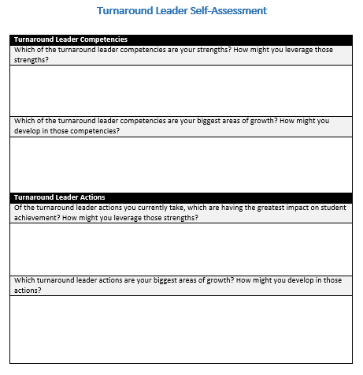
Leader Actions Self-Assessment
A self-assessment allows a school leader to reflect on his or her own practices and evaluate his or her own performance on turnaround leader actions and competencies.
For examples of turnaround leader self-assessments, see Resources slide.

Slide 25
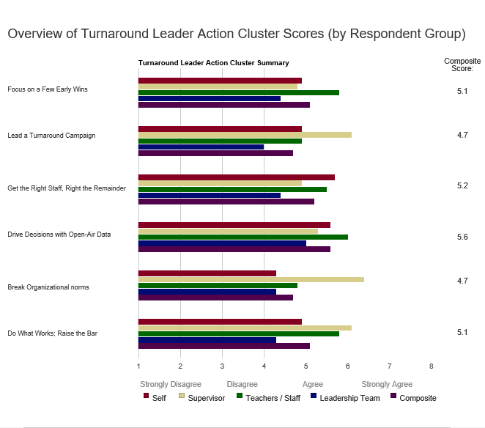
Turnaround Leader 360 Assessment
The 360 Assessment provides developmental feedback on the degree to which turnaround school leaders exhibit research-based turnaround leader actions and competencies.
Feedback is provided anonymously on a Likert scale and in narrative form from the leader’s supervisor, school leadership team members, staff and faculty, and a self-assessment.
For more on this resource, see Resources slide.

Slide 26
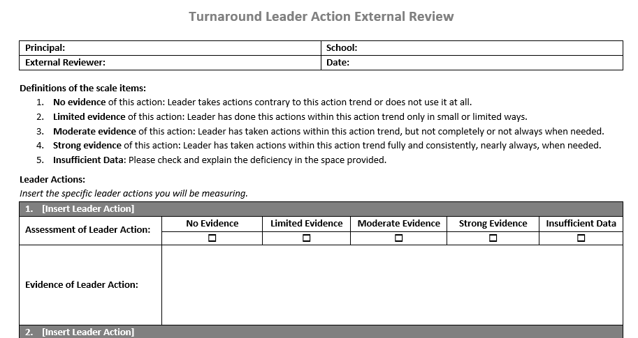
External Review
An external review can measure the extent to which turnaround principals are engaging in the actions that research suggests are critical for success.
These reviews may include conducting interviews and observations and providing feedback that principals can use immediately to improve their leadership capacity.

Slide 27
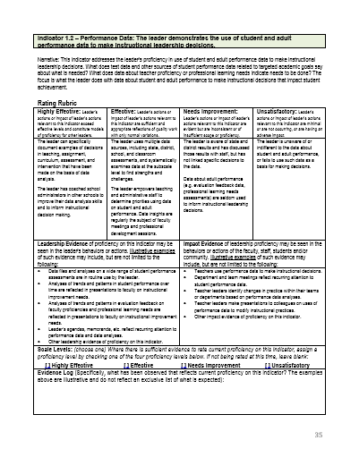
Leader Performance Evaluation
District performance assessments outline the standards and behaviors of school leaders.
Some districts have included turnaround leader competencies and actions in performance assessments of turnaround leaders.
For a sample that includes turnaround leader competencies and actions, see Resources slide.

Slide 28
Activity 3: Turnaround Leader Action Assessment Simulation
Individually
Read transcripts on Principal Rosario and Ms. Roberts, taking notes on the following leader action types:
Vision
Goals
Table groups
Use the blank Turnaround Leader Action External Review to assess the leader.
Whole group
How did you assess this leader?
How would a tool like this be helpful in developing turnaround leaders?
What would you add to the tool, or how would you change it?

Slide 29
Coaching Turnaround Leaders

Slide 30
Effective Professional Development
Training Components | Concept Attainment | Skill Attainment | Classroom Application
Presentation of Theory | 85% | 15% | 5–10%
Modeling | 85% | 18% | 5–10%
Practice and Feedback | 85% | 80% | 10–15%
Coaching | 90% | 90% | 80–90%
(Joyce & Showers, 2002)

Slide 31
“I am altogether more confident and more willing to stand up for my ideas and vision within my organization because of coaching. I am also willing to be more visible within the larger community, which is a big deal for me.”
(CAP Action Guide for Coaches, p. 13)

Slide 32
Coaching Skills
Listen and paraphrase
Be present, listen for the essence, set aside judgment
Acknowledge, clarify, summarize
Ask powerful questions
Ask questions that are open-ended, nonjudgmental, personal, and forward moving
Provide feedback
Ask permission, ground in data, keep bite-sized, align with goals and action/competency development
Hold the leader accountable
E-mail summary of actions, give an exercise to provide practice time, begin session with reflection
Adapted from Cognitive Coaching, 2015

Slide 33
GROW Coaching Cycle
Goal
Identify the specific and measurable change that the leader wants to make.
Reality
Assess the current reality to determine the gap between current performance and the goal.
Options
Way Forward
Brainstorm possible strategies for reaching the goal.
Commit to specific actions for improvement and plan for follow-up to assess progress.
Whitmore, Coaching for Performance, 1992

Slide 34
Activity 4: Coaching Simulation
In small groups:
Plan for coaching conversation using your external review and the GROW template
In pairs:
Round 1
Choose who will be the coach and who will be Principal Rosario.
Role-play coaching conversation.
Reflect on coaching conversation and give feedback.
Round 2
Switch roles.
Role-play coaching conversation.
Reflect on coaching conversation and give feedback.
Full group debrief

Slide 35
Coaching Exercises

Slide 36
Activity 5: Card Sort Plus
In small groups:
Match each coaching exercise with a leader action.
Identify additional coaching exercises.
Full group debrief:
Discuss matches that your group made.
Share coaching exercises that you added.

Slide 37
Creating a Leadership Development Plan

Slide 38
Leadership Development Plan
A leadership development and support plan should consist of both a plan for development and a plan to track progress.
Development Plan
Leader Goals
Strategies: Coaching Actions Coaching Activities
Leader Actions
Coaching Timeline
Tracking Progress
Leader Actions
Implementation Targets: - Teacher/Adult Behaviors - Expected due to Leader Actions
Impact Targets: Student Outcomes
Progress Monitoring Routines

Slide 39
Sample Development Plan

Slide 40
Activity 6: Create a Development Plan
Table groups
Using Principal Rosario’s strengths and areas of growth from the external review and takeaways from your coaching conversation, create a development plan for Principal Rosario.
Whole group
What goals and coaching activities did you plan for Principal Rosario?
In what ways could you track Principal Rosario’s progress?
How would using a plan like this be helpful?
What challenges can you anticipate using a similar tool?

Slide 41
Closing and Next Steps

Slide 42
Wrap-Up: Reflection
3-2-1
3 Ideas
2 Questions
1 Action

Slide 43
Resources
Behavioral Event Interviews
Hitt, D. (2015). “What it takes” for a turnaround: Principal competencies that matter for student achievement. A guide to thoughtfully identifying and supporting school leaders. Center on School Turnaround at WestEd & University of Virginia Darden/Curry Partnership for Leaders in Education. San Francisco, CA: WestEd. Retrieved from http://centeronschoolturnaround.org/new-cst-publication-what-it-takes-for-a-turnaround-principal-competencies-that-matter-for-student-achievement/
Public Impact. (2008). Turnaround Leader Selection Toolkit. Retrieved from http://www.publicimpact.com/publications/Turnaround_Leader_Selection_Toolkit.pdf
Leader Self-Assessment
Public Impact. (2015). Self Assessment: School Turnaround Leader Actions. Retrieved from http://publicimpact.com/web/wp-content/uploads/2016/02/ Turnaround_Leader_Actions_Self-Assessment-Public_Impact.docx
Public Impact. (2015). Self Assessment: School Turnaround Leader Competencies. Retrieved from http://publicimpact.com/web/wp-content/uploads/2016/02/ Turnaround_Leader_Competency_Self-Assessment-Public_Impact.docx

Slide 44
Resources, continued
Turnaround Leader 360 Feedback Assessment
ESC 13 and Public Impact. (2016). Turnaround Leader 360 Feedback Assessment. Retrieved from http://turnaround360.net/
Leader Performance Evaluation
Florida Department of Education. (2012). Observation and Evaluation Forms and Procedures for Leadership Practice. Retrieved from http://www.fldoe.org/core/fileparse.php/7503/urlt/0071810-fslest.pdf

Slide 45
References
Center on School Turnaround. (forthcoming). Turnaround theory in action. San Francisco, CA: WestEd.
Coaching and Philanthropy Project. (2010). An action guide for coaches. Oakland, CA: CompassPoint Nonprofit Services. Retrieved from http://btw.informingchange.com/uploads/2010/03/CAP_Action-Guide-for-Coaches1.pdf
Cooper, Cornier, Dean, Hitt, Kutas, Losoponkul, Lutterloh, and Meyers. (in press). Leading successful school turnarounds: Examples of actions taken by turnaround principals. Center on School Turnaround. San Francisco, CA: West Ed.
Costa, A., & Garmston, R. (2015). Cognitive coaching: Developing self-directed leaders and learners. Lanham, MD: Rowman & Littlefield.
Hitt, D. H. (2015). “What it takes” for a turnaround: Principal competencies that matter for student achievement. A guide to thoughtfully identifying and supporting school leaders. San Francisco, CA: WestEd. Retrieved from http://centeronschoolturnaround.org/wp-content/uploads/2016/01/ CenteronSchoolTurnaround_What_It_Takes.pdf
Joyce, B., & Showers, B. (2002). Designing training and peer coaching: Our needs for learning. Retrieved from http://literacy.kent.edu/coaching/information/Research/randd-engaged-joyce.pdf

Slide 46
References, continued
Kowal, J. M., & Hassel, E. A. (2005). Turnarounds with new leaders and staff: School restructuring options under No Child Left Behind: What works when? Washington, DC: The Center for Comprehensive School Reform and Improvement.
Lutterloh, C., Cornier, J. P., & Hassel, B. C. (2016). Measuring school turnaround success. San Francisco, CA: WestEd. Retrieved from http://centeronschoolturnaround.org/wp-content/uploads/2016/04/CenteronSchoolTurnaround_PublicImpact.pdf
Public Impact. (2015). School turnaround leader actions. Chapel Hill, NC: Author. Retrieved from http://publicimpact.com/web/wp-content/uploads/2015/05/Turnaround_Leader_Actions-Public_Impact.pdf
School Leaders Network. (2014). CHURN: The high cost of principal turnover. Retrieved from http://connectleadsucceed.org/sites/default/files/principal_turnover_cost.pdf
Spencer, L. M., & Spencer, S. M. (1993). Competence at work: Models for superior performance. New York, NY: John Wiley and Sons.

Slide 47
References, continued
Steiner, L., & Hassel, E. A. (2011). Using competencies to improve school turnaround principal success. Charlottesville, VA: University of Virginia Darden/Curry Partnership for Leaders in Education. Retrieved from http://www.darden.virginia.edu/uploadedFiles/Darden_Web/Content/ Faculty_Research/Research_Centers_and_Initiatives/Darden_Curry_PLE/School_Turnaround/ using-competencies-to-improve-school-turnaround.pdf
University of Virginia’s Partnership for Leaders in Education. (n.d.). Leader competencies and turnaround actions shown to influence student achievement. Charlottesville, VA: Author. Retrieved from http://www.darden.virginia.edu/uploadedFiles/Darden_Web/Pages/Faculty_Research/ Research_Centers_and_Initiatives/Darden_Curry_PLE/School_Turnaround/ Turnaround%20Leadership%20Competencies%20and%20Actions.pdf
Whitmore, J. (1992). Coaching for performance: GROWing human potential and purpose. London, UK: Author.
Zhu, G., Hitt, D. H., & Woodruff, D. (2015). Identifying and validating a model for school turnaround. Manuscript submitted for publication.

Slide 48
Partner Organizations
For more information on the Partner Organizations:
Center on Great Teachers and Leaders http://www.gtlcenter.org/
Center on School Turnaround http://centeronschoolturnaround.org/
Public Impact http://publicimpact.com/
Darden/Curry Partnership for Leaders in Education http://www.darden.virginia.edu/darden-curry-ple/

Slide 49
Presenter Name
Address
Phone
E-mail
Website

